Slide 1
Toward Flexible, Efficient Smart Cities: A Network-Application Integration Perspective
Qiao Xiang, Xiamen University
Joint work with many collaborators
11/12/2022

Slide 2
What a Smart City Looks Like
https://medium.com/zify/the-importance-of-smart-cities-2a4f7f89a6cd

Slide 3
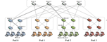
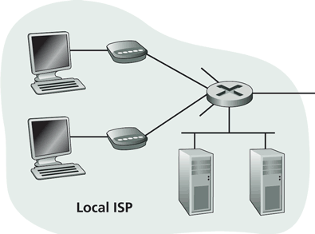
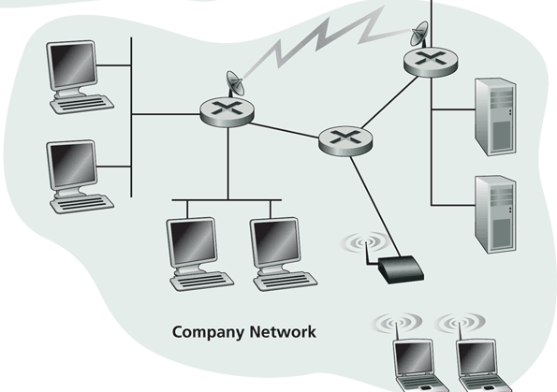
What is Behind a Smart City?
Residential access
Cable, Fiber, DSL, Wireless
ISP
Backbone ISP
ISP
data center
Campus access, e.g.,
Ethernet
Wireless

Slide 4
Driving Question:
How Internet should be redesigned to support efficient, flexible smart cities?

Slide 5


Issues of Current Network Architecture
To application, network is a general-purpose, best-effort black box
To network, different applications are indifferent
s₁
d₁
s₂
d₂

Slide 6
Our Approach: Network-Application Integration
Network: open the black box to provide applications more information to better utilize / control network resources
Application: provide network semantics / instructions to better support application requirements

Slide 7
Roadmap
How (in)efficient current network interfaces can be?
BoxOpt: optimizing in the dark [AAAI-19] [TON-21]

Slide 8
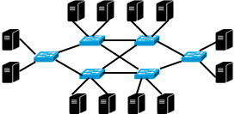
Fairy Tale in Network
Network resource reservation systems (e.g., RSVP)
bring substantial benefits of providing predictable network resources for modern distributed applications (e.g., Hadoop and Spark) .
provide a simple reservation interface for users to submit requests for reserving a specific amount of bandwidth, and return either success or failure.
preserves network privacy, but how about efficiency?
Request bandwidths for flows. I can tell you if you can get them.
What are the optimal bandwidths I can get from network?

Slide 9
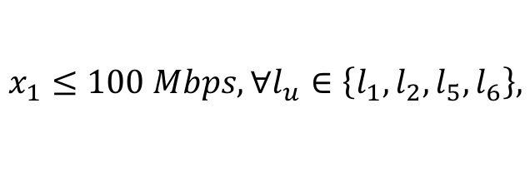
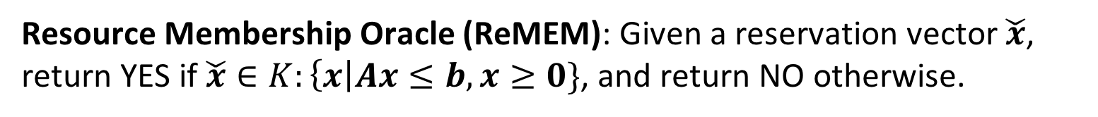
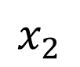
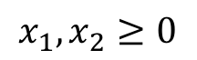
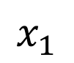

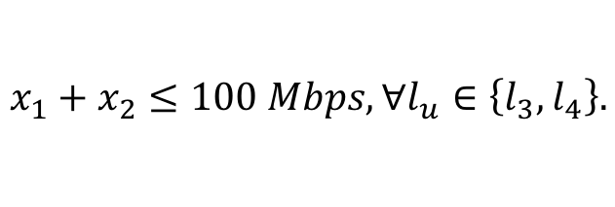
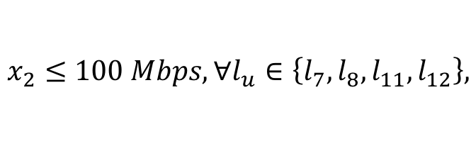
Simple Reservation Interface as a Resource Membership Oracle
The NRR module uses linear inequalities to model the bandwidth availability and sharing information of flows.
Resource Membership Oracle (ReMEM): Given a reservation vector $\check{x}$, return YES if $\check{x}∈K:\left\{x\right|Ax≤b, x≥0\}$, and return NO otherwise.
Bandwidth feasible region $K$
$$x_{1}≤100 Mbps, ∀l_{u}∈\left\{l_{1},l_{2},l_{5},l_{6}\right\},$$
$$x_{1}$$
100
$$x_{2}≤100 Mbps, ∀l_{u}∈\left\{l_{7},l_{8},l_{11},l_{12}\right\},$$
$$x_{1}+x_{2}≤100 Mbps, ∀l_{u}∈\left\{l_{3},l_{4}\right\}.$$
$$x_{2}$$
$$x_{1}, x_{2}≥0$$
100

Slide 10
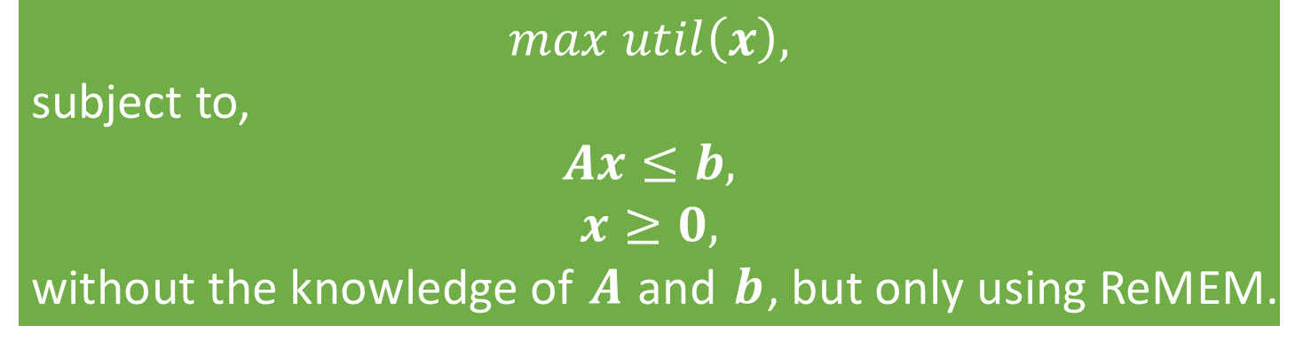
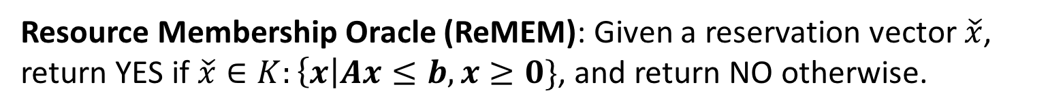
Optimization via Membership Oracle: Problem Definition
Resource Membership Oracle (ReMEM): Given a reservation vector $\check{x}$, return YES if $\check{x}∈K:\left\{x\right|Ax≤b, x≥0\}$, and return NO otherwise.
$$max util\left(x\right),$$
subject to,
$$Ax≤b,$$
$$x≥0,$$
without the knowledge of $A$ and $b$, but only using ReMEM.

Slide 11
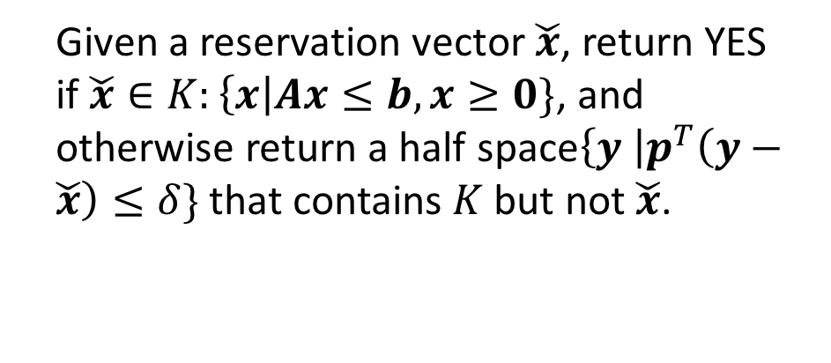
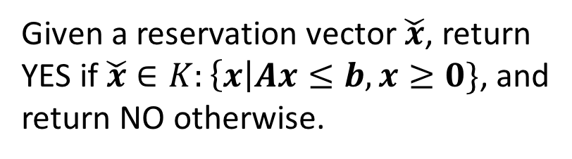
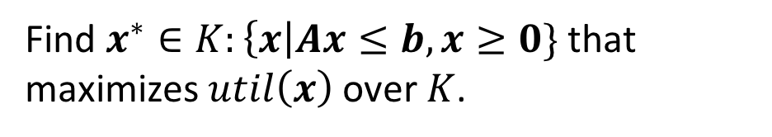
Optimization via Membership Oracle: Roadmap
Resource
Optimization Oracle
Find $x^{∗}∈K:\left\{x\right|Ax≤b, x≥0\}$ that maximizes $util\left(x\right)$ over $K$.
Reservation
Vector
Yes /
Separation Half Space
Given a reservation vector $\check{x}$, return YES if $\check{x}∈K:\left\{x\right|Ax≤b, x≥0\}$, and otherwise return a half space$\left\{y \right|p^{T}\left(y−\check{x}\right)≤δ\}$ that contains $K$ but not $\check{x}$.
Resource
Separation Oracle
Reservation
Vector
Yes / No
Given a reservation vector $\check{x}$, return YES if $\check{x}∈K:\left\{x\right|Ax≤b, x≥0\}$, and return NO otherwise.
Resource
Membership Oracle

Slide 12
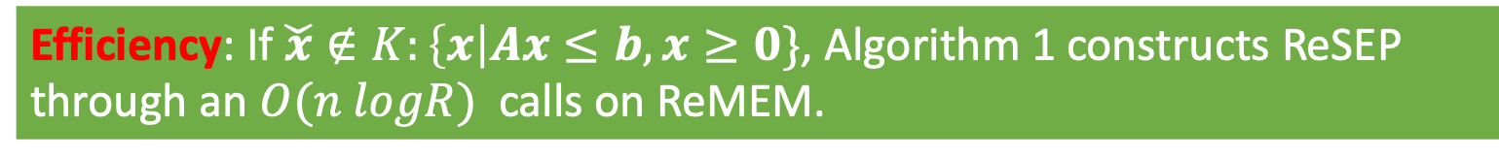

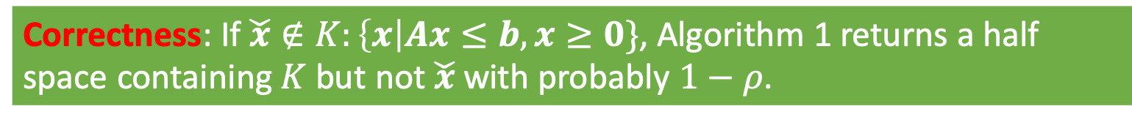
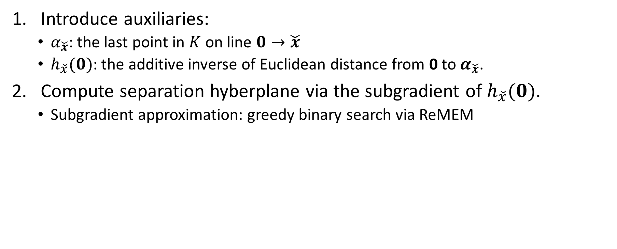
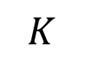


From ReMEM to ReSEP: Basic Idea
Correctness: If $\check{x}∉K:\left\{x\right|Ax≤b, x≥0\}$, Algorithm 1 returns a half space containing $K$ but not $\check{x}$ with probably $1−ρ$.
Introduce auxiliaries:
$α_{\check{x}}$: the last point in $K$ on line $0→\check{x}$
$h_{\check{x}}(0)$: the additive inverse of Euclidean distance from 0 to $α_{\check{x}}$.
Compute separation hyberplane via the subgradient of $h_{\check{x}}(0)$.
Subgradient approximation: greedy binary search via ReMEM
Efficiency: If $\check{x}∉K:\left\{x\right|Ax≤b, x≥0\}$, Algorithm 1 constructs ReSEP through an $O(n logR)$ calls on ReMEM.
$$\check{x}$$
$$K$$
$$α_{\check{x}}$$
$$0$$

Slide 13

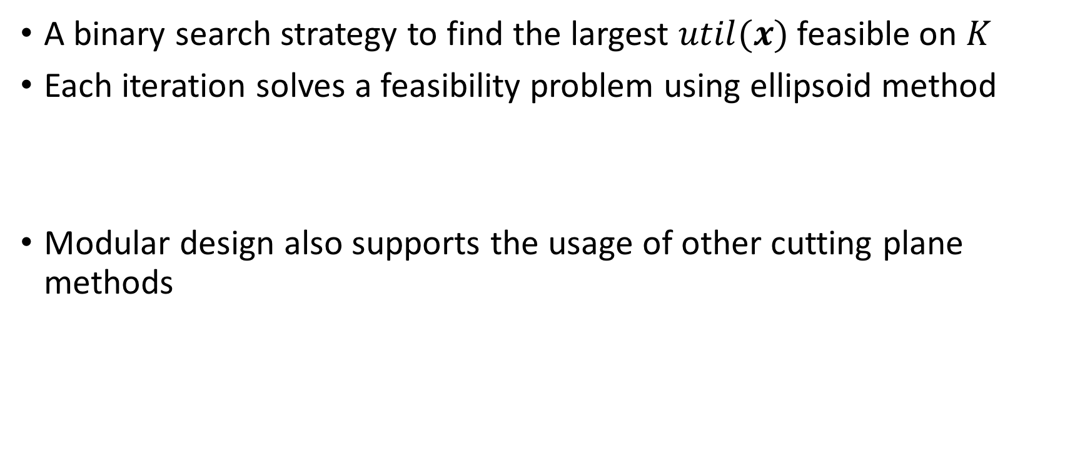
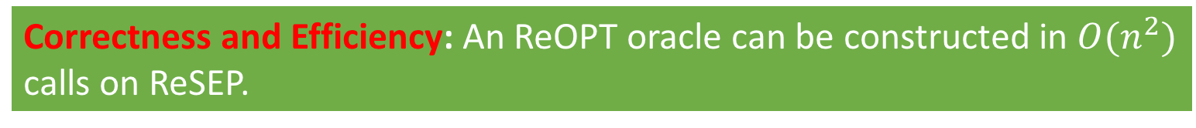
From ReSEP to ReOPT
A binary search strategy to find the largest $util(x)$ feasible on $K$
Each iteration solves a feasibility problem using ellipsoid method
Modular design also supports the usage of other cutting plane methods
$$util\left(x\right)≥u_{next},$$
$$Ax≤b,$$
$$x≥0,$$
Correctness and Efficiency: An ReOPT oracle can be constructed in $O(n^{2})$ calls on ReSEP.

Slide 14
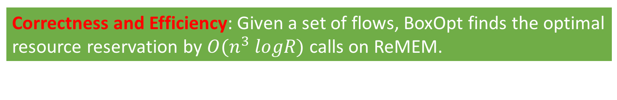
Putting Things Together
ARO Controller
Resource
Optimization Oracle
Reservation
Vector
Inferred
Search Space
Reservation
Vector
Yes /
Separation Half Space
ARO Scout
Resource
Separation Oracle
Reservation Vector
Success / Failure
Reservation
Vector
Yes / No
Network Resource Reservation Module
Resource
Membership Oracle
Correctness and Efficiency: Given a set of flows, BoxOpt finds the optimal resource reservation by $O(n^{3} logR)$ calls on ReMEM.

Slide 15
Performance Evaluation
Topology: a large federation network with 62 institutes and hundreds of network elements (i.e., switches/routers)
Traffic: a 48-hour flow reservation trace with a total of 716 reservation requests
Number of flows in each request ranges from 1 to 7.
Users' objective function: maximal throughput and maximal weighted throughput

Slide 16
Efficiency and Scalability of BoxOpt
Communication latency of BoxOpt with different sizes of request.
CDF of the communication latency of BoxOpt.
For 95% of requests, BoxOpt learns the optimal resource reservation within 13 seconds (assuming the user is in NYC and the network is in LA)

Slide 17
Efficiency Breakdown: from ReMEM to ReSEP
Number of ReMEM invocations with different sizes of request.
CDF of the number of ReMEM invocations.
In BoxOpt, 95% of ReSEP can be constructed within less than 30k ReMEM calls.

Slide 18
Summary
Good news
BoxOpt: a learning system that automatically learns the optimal resource reservations without exchanging any private information between the network and the user.
Bad news
13s with a proxy on the network side and 30k ReMEM calls, are we happy?

Slide 19
Roadmap
How (in)efficient current network interfaces can be?
BoxOpt: optimizing in the dark [AAAI-19] [TON-21]
How can we redesign network interfaces to let applications better utilize network resources w/o such repeatedly try-and-error?
Mercator: multi-domain resource orchestration using linear-inequality abstraction [SC-18] [JSAC-19]

Slide 20
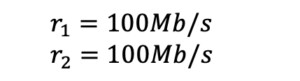
Strawman: Application Layer Traffic Optimization Protocol
RFC 7285 since 2014
Basic idea: use a one-big-switch abstraction to provide applications end-to-end network information
Limitation: cannot reveal the shared bottleneck resources between analytics tasks.
Resource information provided by one-big-switch abstraction
s₁
d₁
s₂
d₂
$$r_{1}=100Mb/s$$
$$r_{2}=100Mb/s$$

Slide 21
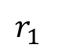
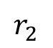
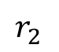
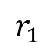
One-Big-Switch Abstraction: Ambiguity
$$r_{1}$$
No shared resources
Shared resources
100
$$r_{2}$$
100
Feasible region
$$r_{1}$$
100
$$r_{2}$$
100
Feasible region

Slide 22
Mercator Resource Abstraction
Basic idea: Use linear inequalities to provide a compact representation of multi-domain network available bandwidth.
$$x_{1}$$
100
$$x_{2}$$
100
Geometrically, resource abstraction represents the bandwidth feasible region of network for providing bandwidths to this set of circuits.
Redundant inequalities are removed via a polynomial-time, optimal algorithm.
Notes:
Our idea: on-demand, partianl-instantiation

Slide 23
Resource Abstraction: Accuracy
Resource abstraction provides a compact, accurate representation of multi-domain network available bandwidth.
A fair optimal solution: $x_{1}=10, x_{2}=5, x_{3}=5$
Step 5
Notes:
Our idea: on-demand, partianl-instantiation

Slide 24
Resource Abstraction: Privacy Concern
Resource abstraction represents the bandwidth feasible region of network for providing bandwidths to this set of flows.
Such regions are also private information.
Aggregator becomes single point of failure.
Step 5
Notes:
Our idea: on-demand, partianl-instantiation

Slide 25
Mercator: Key Components
Resource abstraction: Use linear inequalities to provide a compact representation of multi-domain network available bandwidth.
Resource abstraction obfuscating: Merge the resource abstraction of multiple domains without revealing the abstraction of individual domain.
Notes:
Our idea: on-demand, partianl-instantiation

Slide 26
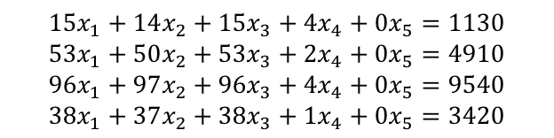
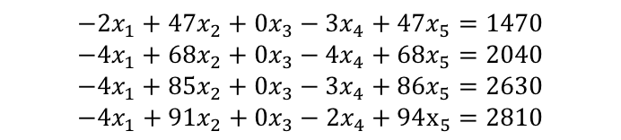

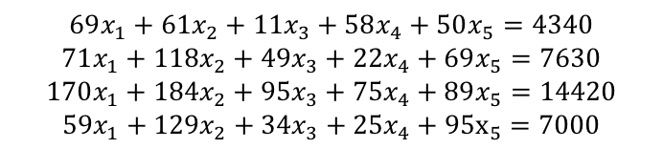
Resource Abstraction Obfuscating Protocol: Example
$$69x_{1}+61x_{2}+11x_{3}+58x_{4}+50x_{5}=4340$$
$$71x_{1}+118x_{2}+49x_{3}+22x_{4}+69x_{5}=7630$$
$$170x_{1}+184x_{2}+95x_{3}+75x_{4}+89x_{5}=14420$$
$$59x_{1}+129x_{2}+34x_{3}+25x_{4}+95x_{5}=7000$$
Aggregator
Maximizing $x_{1}+x_{2}$ subject to either feasible region would get the optimal solution $x_{1}=x_{2}=30$.
Mercator Server 1
Mercator Server 2
Mercator Server 3
$$15x_{1}+14x_{2}+15x_{3}+4x_{4}+0x_{5}=1130$$
$$53x_{1}+50x_{2}+53x_{3}+2x_{4}+0x_{5}=4910$$
$$96x_{1}+97x_{2}+96x_{3}+4x_{4}+0x_{5}=9540$$
$$38x_{1}+37x_{2}+38x_{3}+1x_{4}+0x_{5}=3420$$
$$−2x_{1}+47x_{2}+0x_{3}−3x_{4}+47x_{5}=1470$$
$$−4x_{1}+68x_{2}+0x_{3}−4x_{4}+68x_{5}=2040$$
$$−4x_{1}+85x_{2}+0x_{3}−3x_{4}+86x_{5}=2630$$
$$−4x_{1}+91x_{2}+0x_{3}−2x_{4}+94x_{5}=2810$$
$$56x_{1}+0x_{2}−4x_{3}+57x_{4}+3x_{5}=1740$$
$$22x_{1}+0x_{2}−4x_{3}+24x_{4}+x_{5}=680$$
$$78x_{1}+2x_{2}−x_{3}+74x_{4}+3x_{5}=2250$$
$$25x_{1}+0x_{2}+0x_{3}+25x_{4}+0x_{5}=770$$
$$Π_{1}\left(F_{1}\right):\left\{x_{1}+x_{2}≤100\right\}$$
$$Π_{2}\left(F_{2}\right):{\{x}_{1}≤30\}$$
$$Π_{3}\left(F_{3}\right):{\{x}_{2}≤30\}$$

Slide 27
Mercator: Key Components
Resource abstraction: Use linear inequalities to provide a compact representation of multi-domain network available bandwidth.
Resource abstraction obfuscating: Merge the resource abstraction of multiple domains without revealing the abstraction of individual domain.
Super-set projection: Improve the system scalability via pre-computation and projection.
Notes:
Our idea: on-demand, partianl-instantiation

Slide 28
Mercator: Putting Pieces Together
Goal: Provide fine-grained, global network resource information, to optimize large-scale, multi-domain data transfers.
User submits a resource discovery request of a set of circuits to a logically centralized aggregator;
Aggregator decomposes the request and forwards it to Mercator domain servers at networks;
Mercator servers compute, obfuscate and return resource abstraction to aggregator
Aggregator composites the information and returns to user;
User computes and sends reservation requests to reservation systems at networks.
Step 5
Notes:
Our idea: on-demand, partianl-instantiation

Slide 29
Benefits of Mercator
Objective: max-min fairness
Objective: total throughput
An average of 2x improvement of fairness
An average of 15% improvement of throughput

Slide 30
Benefits of Mercator
Request failure ratio of probe-requests-based systems
Resource discovery latency
An average of 100x improvement of resource discovery latency
Probe-requests-based systems have an average of 73% request failure ratio.

Slide 31
Efficiency of Resource Abstraction Obfuscating
Obfuscating latency
Obfuscated data transmission
The resource abstraction obfuscating protocol scales to up to 200 member network.

Slide 32
Summary
Mercator, a multi-domain network resource discovery System, to provide fine-grained, global network resource information, to optimize large-scale, multi-domain data transfers.
Pre-production deployed at CMS-US sites to orchestrate 100Gbps workflows
Question
Mercator assumes routes are given. What if the given routes have poor performance?
Application can try to control intradomain routes using segment routing, SDN, etc.
What about interdomain routes?

Slide 33
Roadmap
How (in)efficient the current network interfaces can be?
BoxOpt: optimizing in the dark [AAAI-19] [TON-21]
How can we redesign network resource interfaces to let applications better utilize network resources w/o such repeatedly try-and-error?
Mercator: multi-domain resource orchestration using linear-inequality abstraction [SC-18] [JSAC-19]
How can we redesign interdomain routing interfaces to let applications flexibly control interdomain routes?
SDI: software-defined internetworking [INFOCOM-20] [INFOCOM-21]

Slide 34
Control Model: Abstract AS as Virtual Switch
Single domain SDN is very well understood, SDI aims to achieve similar things in interdomain setting
Each AS abstracted as a virtual switch with a pipeline of match-action tables and path-ports (i.e., AS paths)
Each AS becomes an SDI-net
packet
Port 1
[A, B, D]
packet
Port 1
Match
Action
Match
Action
Port 2
[B, D]
Port 2
Pipeline of
match-action tables
Flexible forwarding
S
A
B
D
S
D
B
A
Single domain SDN
Interdomain Network
Notes:
TODO: One more link between A and B
There's a set of ports for every prefix
Parallel figures
===
Contritbuion 1
Single domain sdn is very well understood, /accepted
We want to achieve similar things in interdomain setting
In particular
LHS: a simple switch topology
RHS: interdomain netowork, with simple switches in each network
Every as becomse fleixble as sinlge domain SDN switch (e.g., pipeline, multi-port, LB, )

Slide 35
Control Model: Control SDI Network
A client connects to SDI-nets to control paths in interdomain network
A client may select to control a subset of SDI-nets to simplify management and business arrangements
B
E
F
B
G
I
S
A
D
F
H
T
S
A
E
D
C
H
G
C
Notes:
TODO: Each switch called an SDI net
Sure m
ultipel paths, go to same dst, etc.
No payment here client: control plaen connection to every single swtich, or a subset of virtual switches call it SDI-net (comment: they can control a subset of them, , simplify management/business, arrange business relationship)

Slide 36
What We Have Accomplished
(In)efficiency of the current network reservation interface
Optimization via oracle transformation
Redesign of network resource interfaces:
Network resource information exposure using linear-inequality abstraction
Redesign of interdomain routing interfaces:
Software-defined internetworking using programmable interfaces and blackbox optimization
Open the blackbox of network and empower smart city applications with flexible control over network

Slide 37

Many Open Questions Awaits for Us
Unified, smart city application-network co-programming
Fine-grained, multi-resource, multi-domain orchestration among multiple smart city applications
High application service availability
…
Thank you!
Please drop me an email (xiangq27@gmail.com / qiaoxiang@xmu.edu.cn) if you are interested.

